Slide 1
A New Approach to Detecting Frame Deletion in H.264 Encoded Digital Video
Hunter Kippen
Advisor: Dr. Matthew Stamm
Drexel University
hmk64@drexel.edu

Slide 2
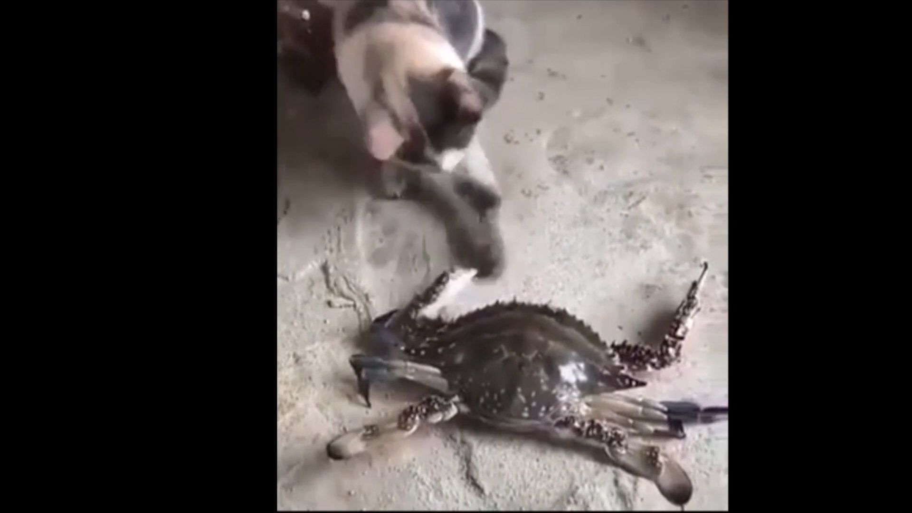
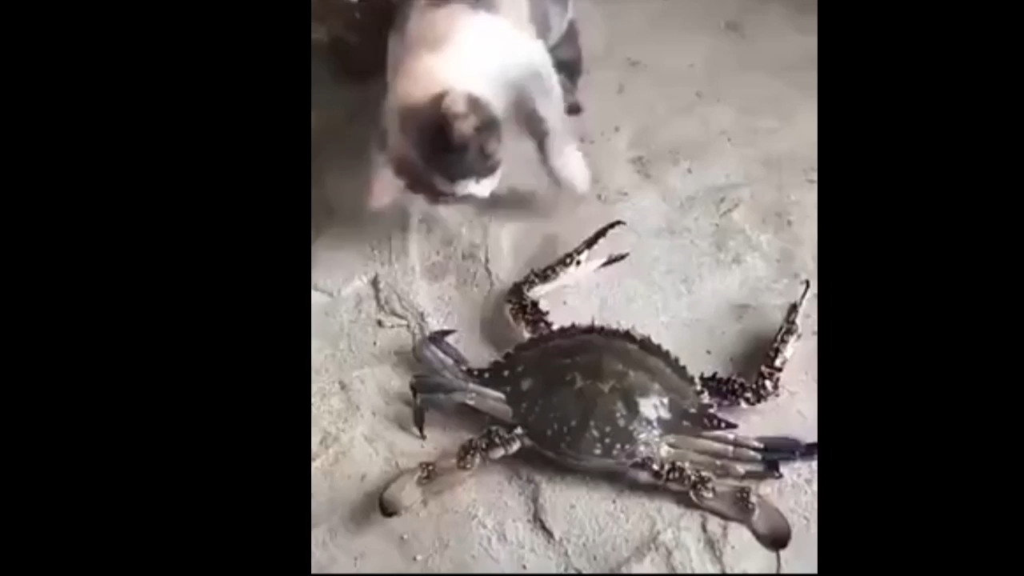
Video Tampering
Digital videos are used as evidence of events
Software can create perceptually undetectable forgeries

Slide 3
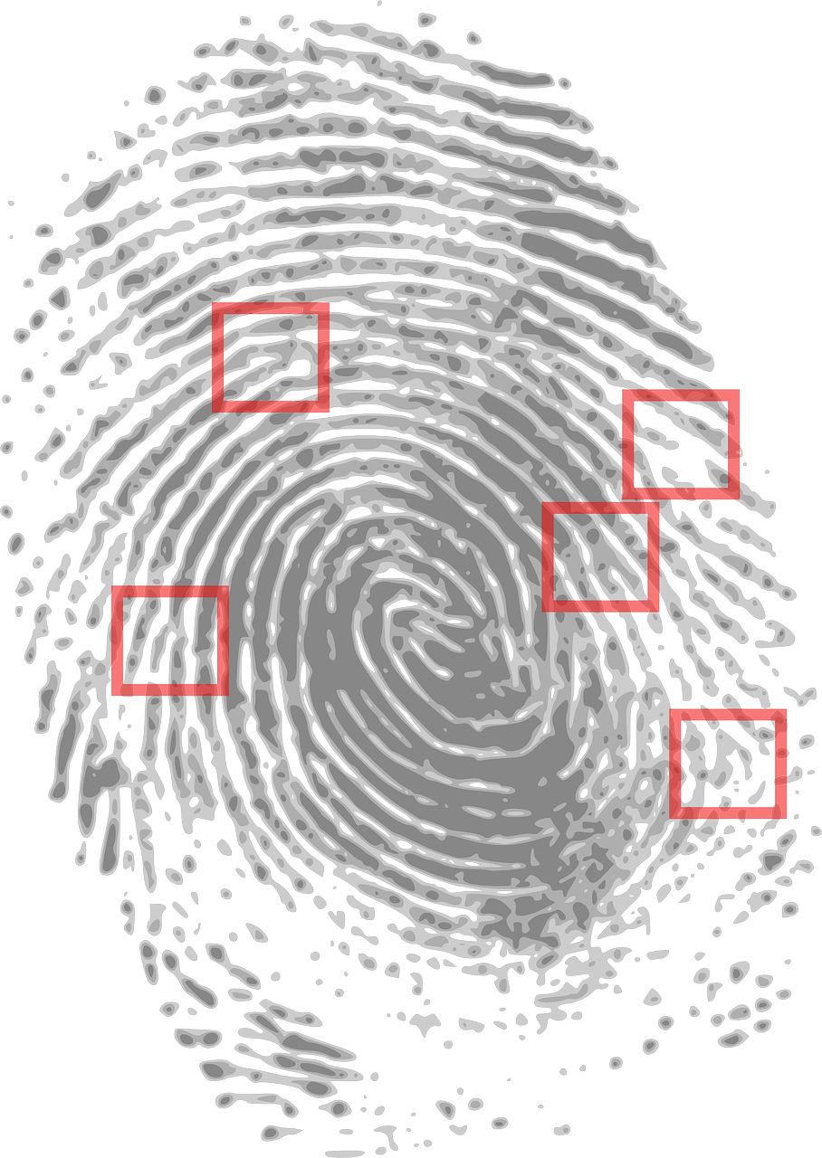
Multimedia Forensics
Forensics can provide information about authenticity when the information source is not trusted
Detect traces known as fingerprints left by processing and manipulation
Left by the capture process
Introduced by editing operations
Video frame deletion is one such operation

Slide 4
Video Frame Deletion
Frame deletion occurs when a frame or sequence of frames are removed from a video
Potential effects include:
Removing the context
Removing the presence of objects
Often visually undetectable

Slide 5
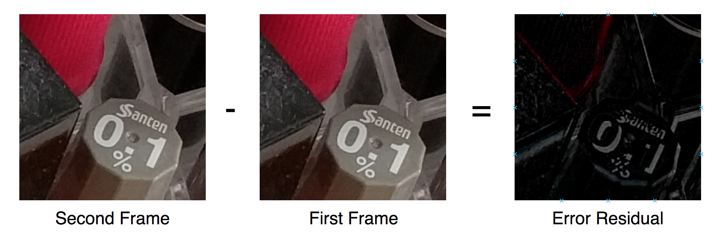
Video Compression Overview
Subsequent video frames are similar
Can predict the content of the current frame from a previous frame
Encoder stores motion vectors and error residuals

Slide 6
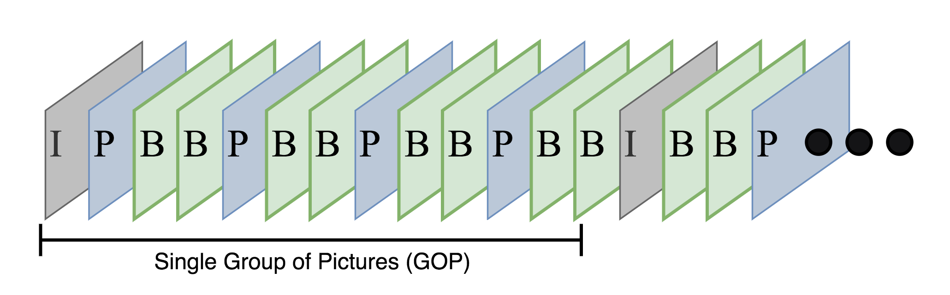
Group of Pictures
Frames are separated into Groups of Pictures (GOP)
Prediction occurs only within each GOP
Each GOP contains three frame types
Intra-frames (I-frames)
Predicted-frames (P-frames)
Bidirectional-frames (B-frames)

Slide 7
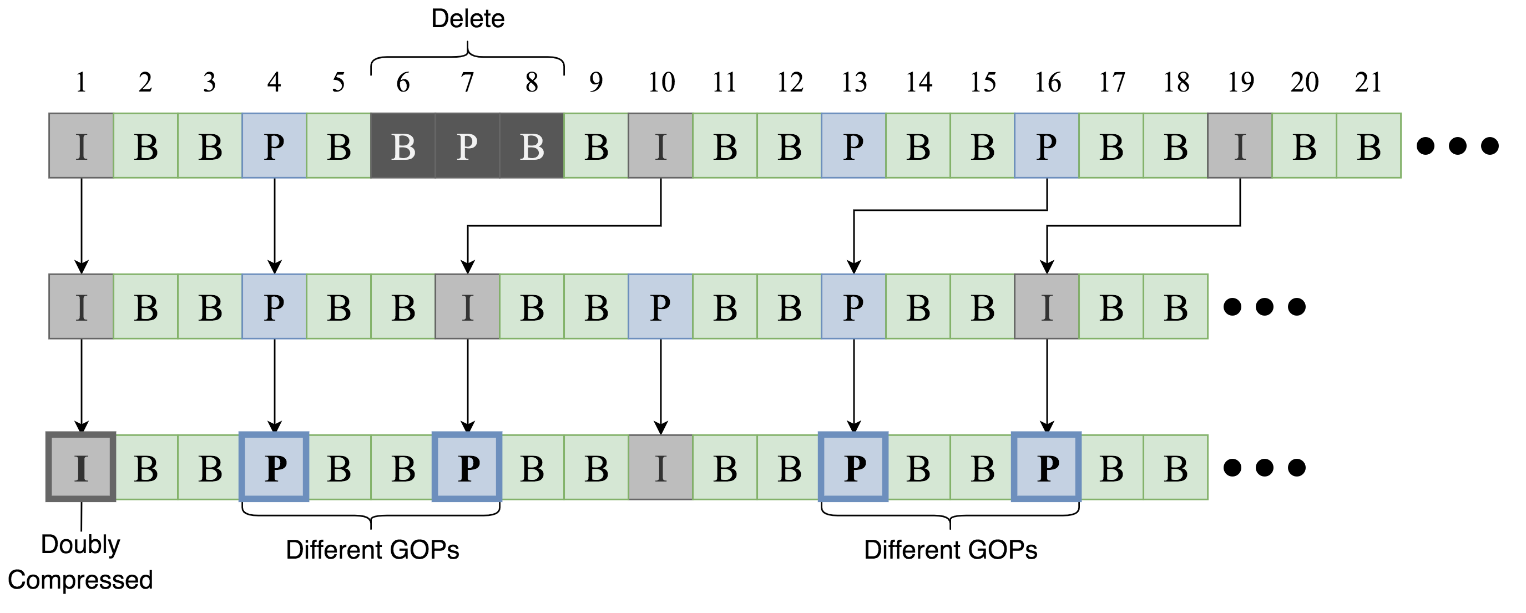
Frame Deletion Fingerprints
Frame deletion affects P-frame prediction error
Frames predicted within same GOP have less prediction error
Frames predicted across old GOPs have greater prediction error
Frame deletion and addition introduces a temporal fingerprint [Wang & Farid 2006]

Slide 8
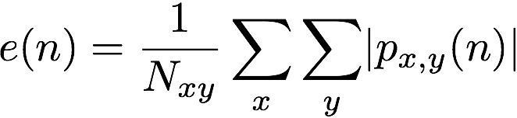
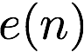
Frame Deletion Fingerprints
Define P-frame error signal as
Temporal fingerprint results in a pattern of increased values
Can visually inspect the DFT of the P-frame error signal to detect frame deletion [Wang & Farid 2006]
Visual inspection is prone to human error
Not feasible for large scale operation
P-frame index
prediction error

Slide 9
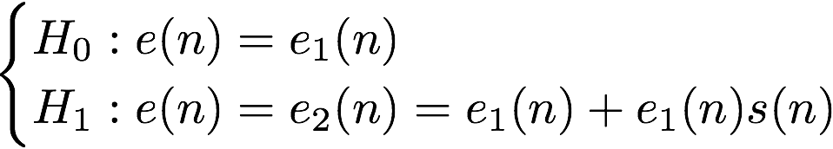
Automatic Detection
Automatic detection methods were formulated for detecting frame deletion [Stamm et al. 2012]
Model prediction error sequence for video with frame deletion
Decision formulated as a hypothesis test

Slide 10
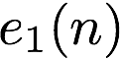
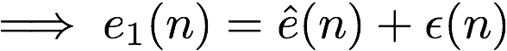
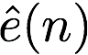
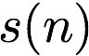
Automatic Detection
Need to extract estimate of temporal fingerprint
Process incoming to estimate
From estimate

Slide 11
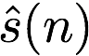
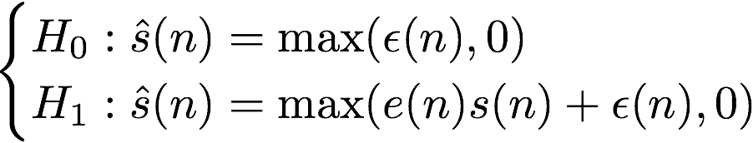
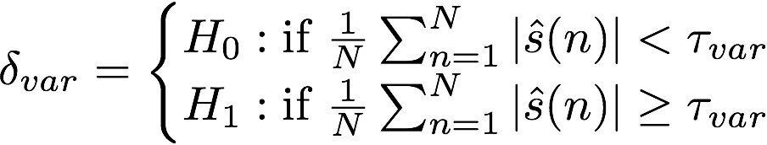
Automatic Detection
Reframe hypothesis test in terms of
Use a decision function based on the energy of [Stamm et al. 2012]

Slide 12
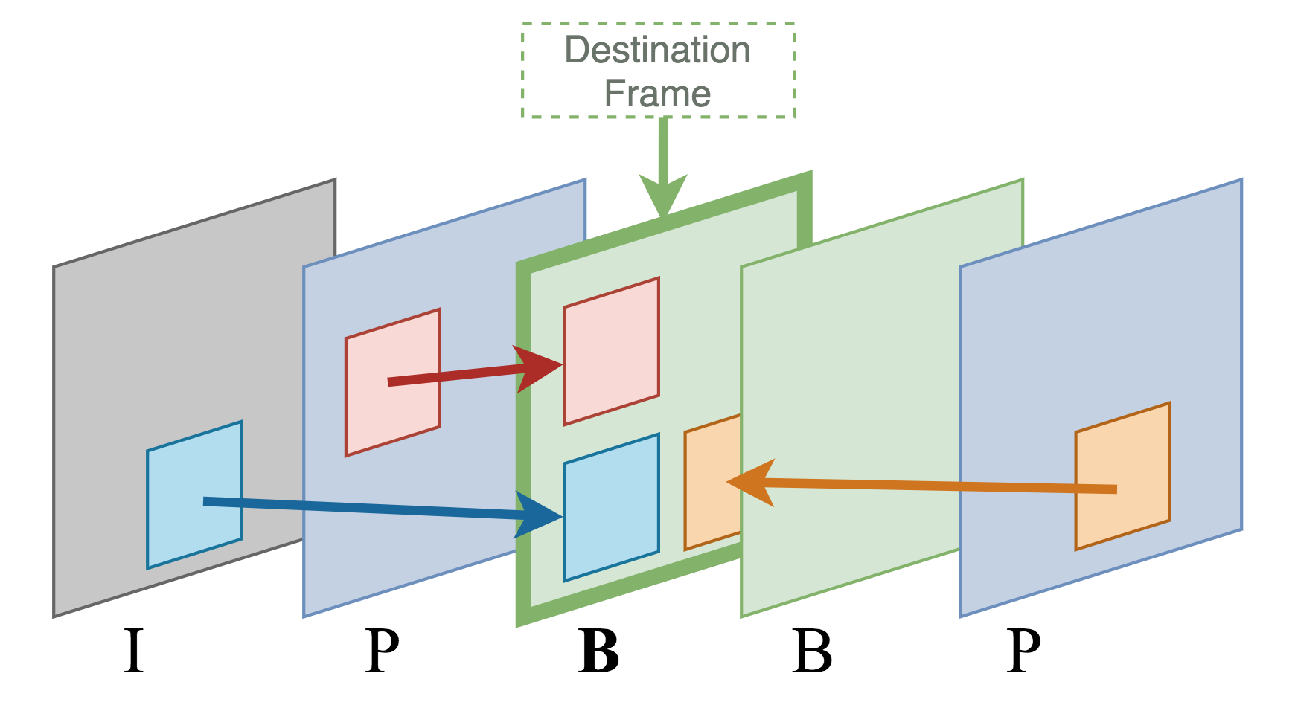
Automatic Detection
Decision function formulated for MPEG-2 video
H.264 standard updates inter-frame prediction process
It is unclear whether the frame deletion fingerprint is expressed in H.264 encoded video.

Slide 13
Preliminary Experiment
Testing detector performance on H.264 video requires a dataset
The dataset was gathered using one camera model
ASUS ZenFone 3 Laser
257 - 5 second long videos
Variety of lighting conditions (indoor & outdoor)
Variety of motion and scene content
For each video in the dataset, we
Decoded the video
Removed the first 15 frames (Half GOP)
Reencoded the video using the same encoding parameters

Slide 14
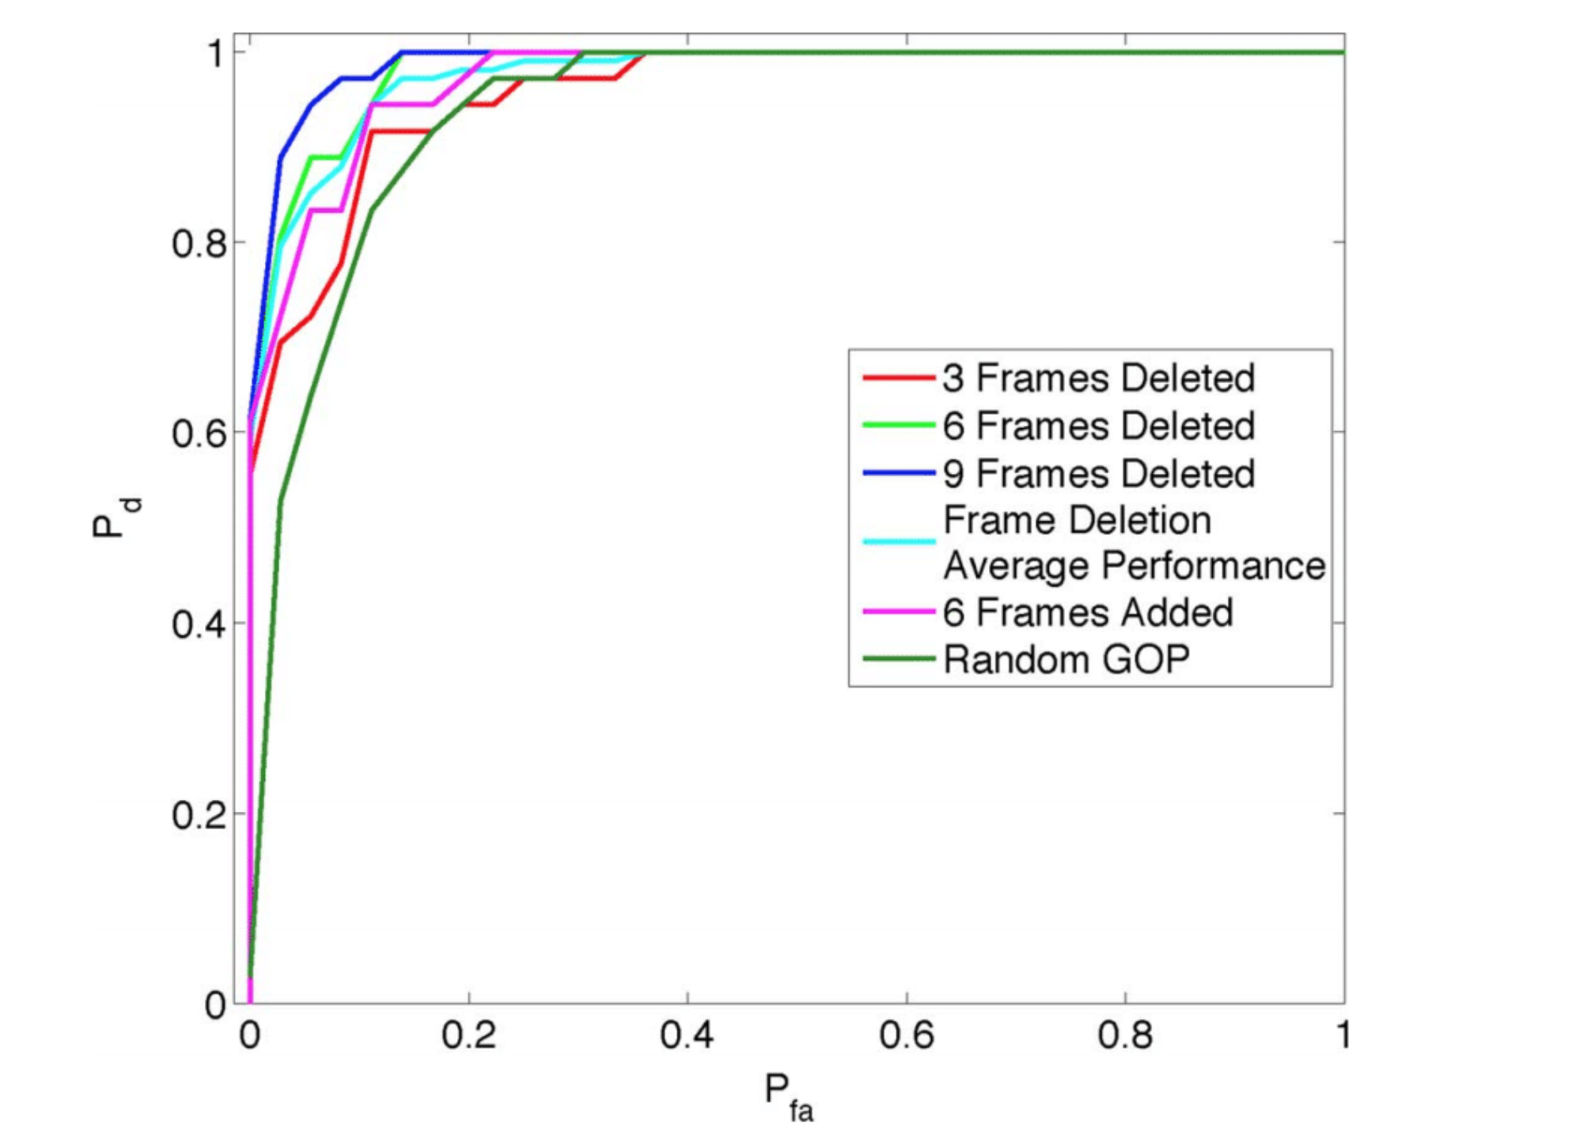
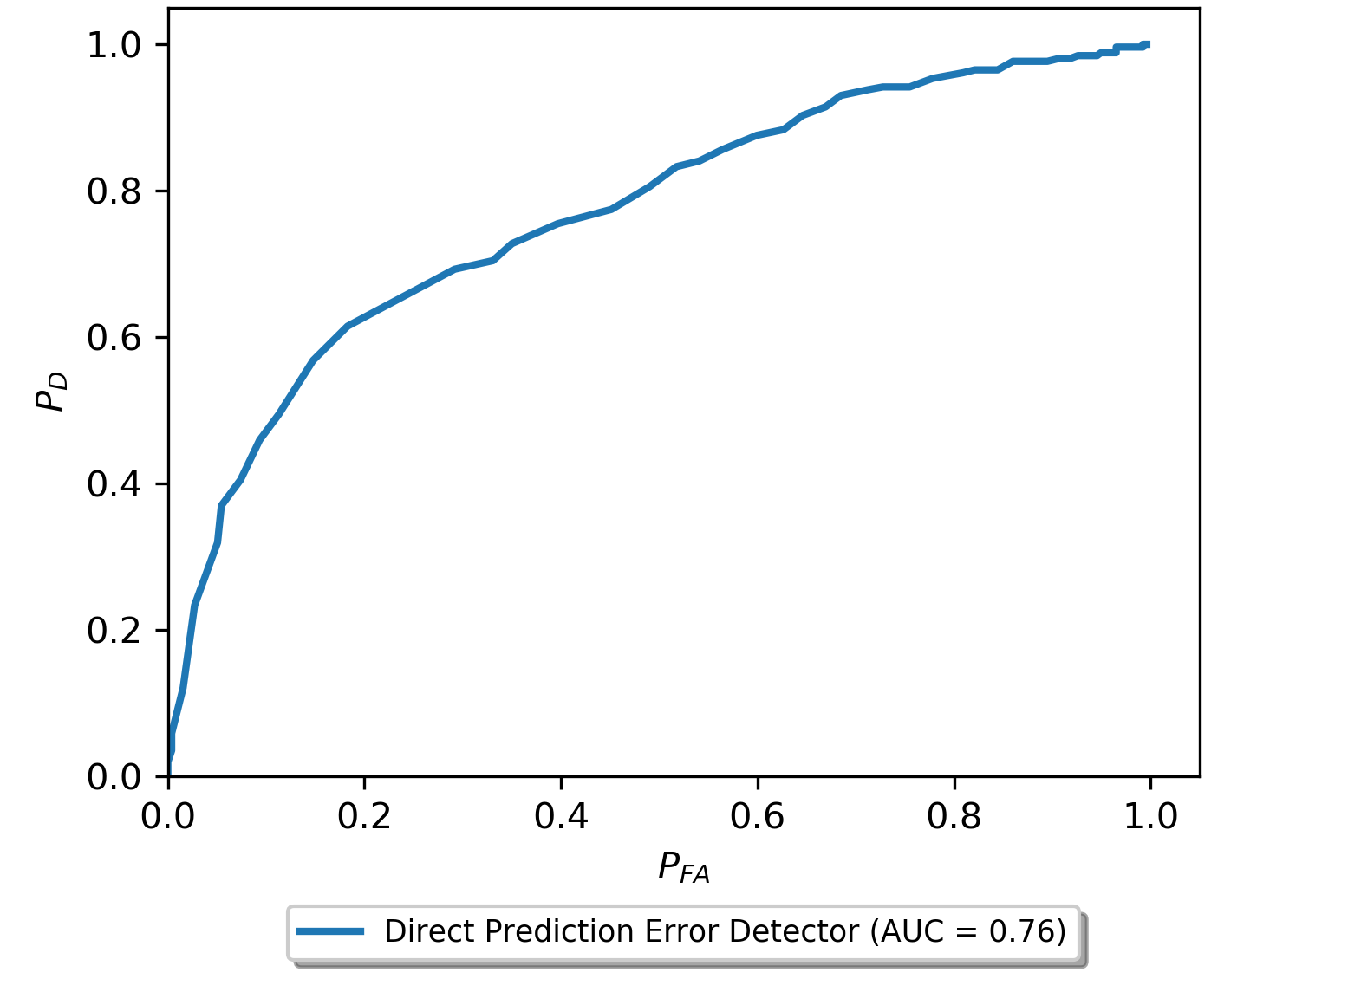
Preliminary Experiment
Fingerprint is not strongly expressed in H.264 video
We need new prediction error extraction methods
*Figure reprinted with permission from Stamm et al.

Slide 15
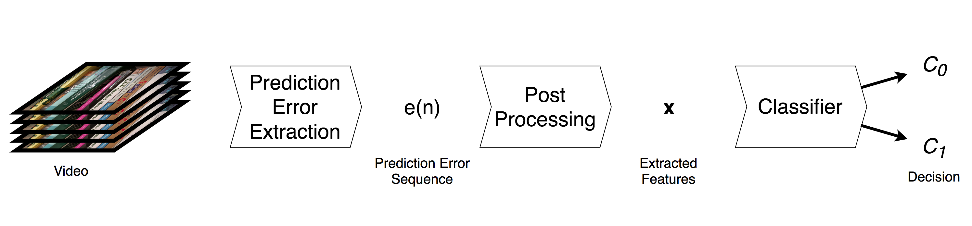
General Frame Deletion Detection Approach
Frame deletion detection can be thought of as a binary classification problem
Given a video V

Slide 16
General Frame Deletion Detection Approach
Given extracted features x

Slide 17
Assumptions
All source videos have been initially compressed using H.264 or MPEG-4
Altered video undergoes recompression using H.264
GOP structure of reencoded video matches original video
Videos are of sufficient length
Frame deletion does not occur at the end of the video

Slide 18
Assumptions
A user will not need physical access to devices
Function on videos of any
Length
Resolution
Frame rate
GOP structure
Data driven approach
Labeled Dataset required

Slide 19
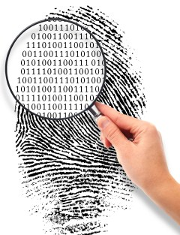
Multimedia Forensics
Forensics can provide information security when the information source is not trusted
Detect traces known as fingerprints
left by processing and manipulation
Left by camera components
Introduced by editing operations
Forensic research conducted by MISL:
Develop forgery detection algorithms
Develop source identification approaches
Create and study anti-forensic techniques

Slide 20
Summary
Forensic traces left by processing
Editing operations
Source camera
These forensic traces can be used to
Expose editing
Determine source
Identify forgeries
Inconsistencies in traces such as LCA can be used expose forgeries
Specially designed CNNs can be used to automatically learn forensic traces
Deep learning techniques can be used to approach problems such as
Identify unknown image/video sources
Expose forgeries by detecting processing & source inconsistencies

Slide 21
Multimedia Forensics Using Machine Learning and Mathematics to Detect Multimedia Forgeries
Matthew C. Stamm
Multimedia & Information Security Lab
Drexel University
mstamm@drexel.edu

